Slide 1

Highlights on HCI Application
By JMC-ICT 2020

Slide 2
Contents to covered
Access HCI
User Management
System Setting and Configuration
Patient Registration
Client Management
Create encounter and view status
Service payment info
Reports
Communication

Slide 3
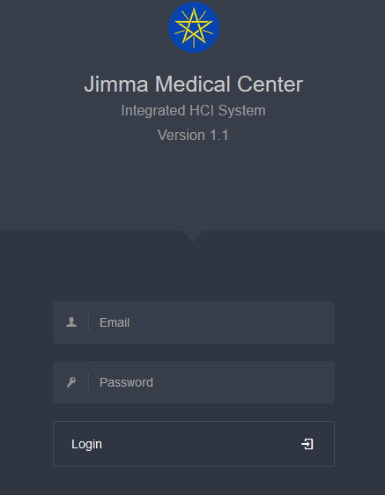


Accessing HCI
Web Application
Accessible through any browser
To Login to HCI, you need:
Email
Password
10.142.65.143/hci.ju.edu.et

Slide 4
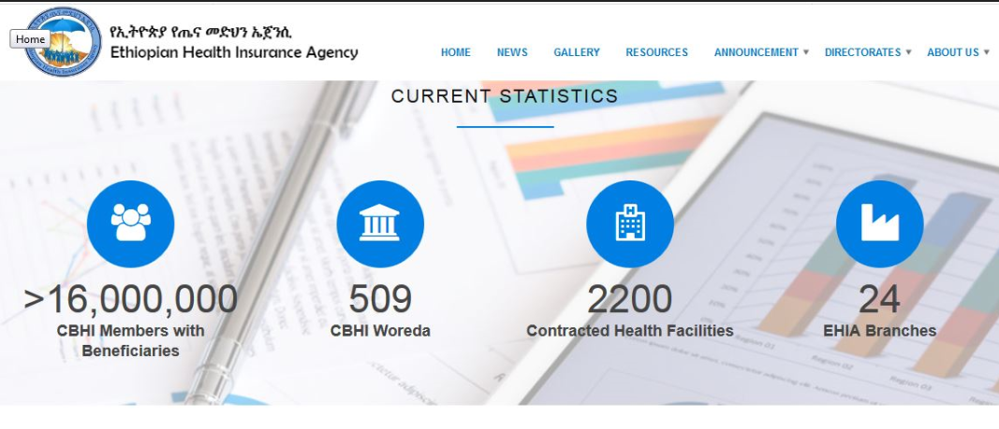
Adapted from EHIA Website, 2012

Slide 5
Problems Identified
Error prone insurance code
Disagreement between JMC and it clients
Not trust each other
Service charge payment delay
Heavy Workload while increasing insurance patient
Poor fiancé management
Non central administration
Preparing payment report require a lot of times
Incomplete insurance information
Low health quality due to delay internal revenue

Slide 6
Our New system
Totally eliminate above mentioned list of problems!

Slide 7
User Classification
System user
Super Users
Insurance user
Accountant
Finance head
Super Administrator
System Administrator

Slide 8
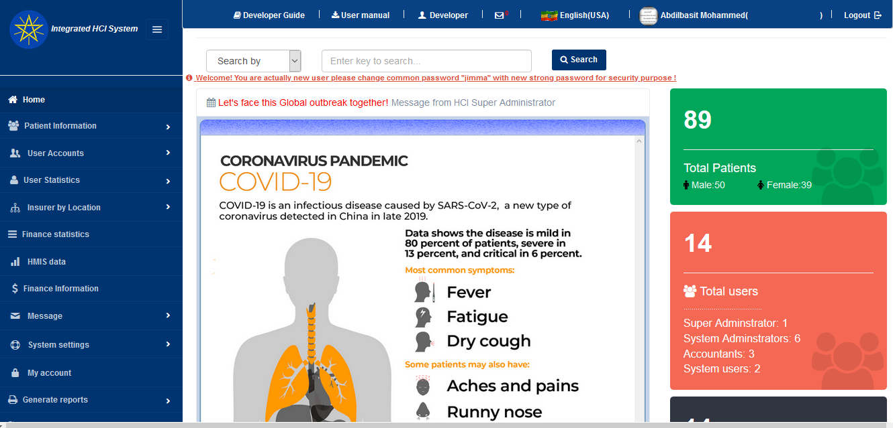
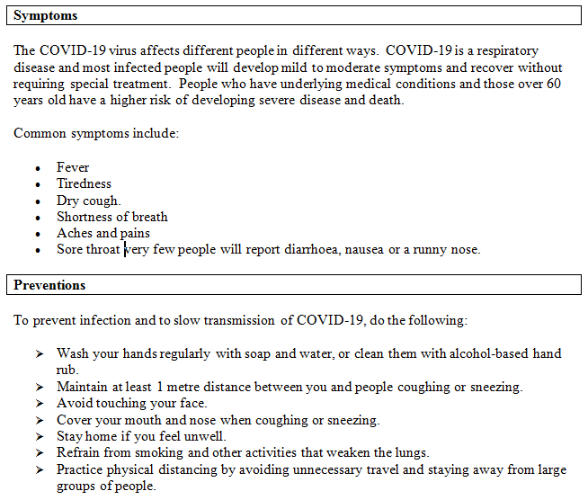
Home Page

Slide 9
Patient Classes
Note: Those who don’t pay from pocket
Health care finance patients
-Who get healthcare via legal letter
Community based health insurance(CBHI)
- Include family on CBHI Book from Woreda
Credit service
-Employee
-Students
NB: naming of system “hci.ju.edu.et”

Slide 10
General Objective ➔Link JMC with its Clients or Insurers
Create patient profile with finance details
Record patient encounter
Calculate fee by service type and encounter date
Create agreement with woreda and organization
Generate payment request report by
-Monthly
-Quarterly
-Costumed
For personal, group, single agreed organization or district

Slide 11
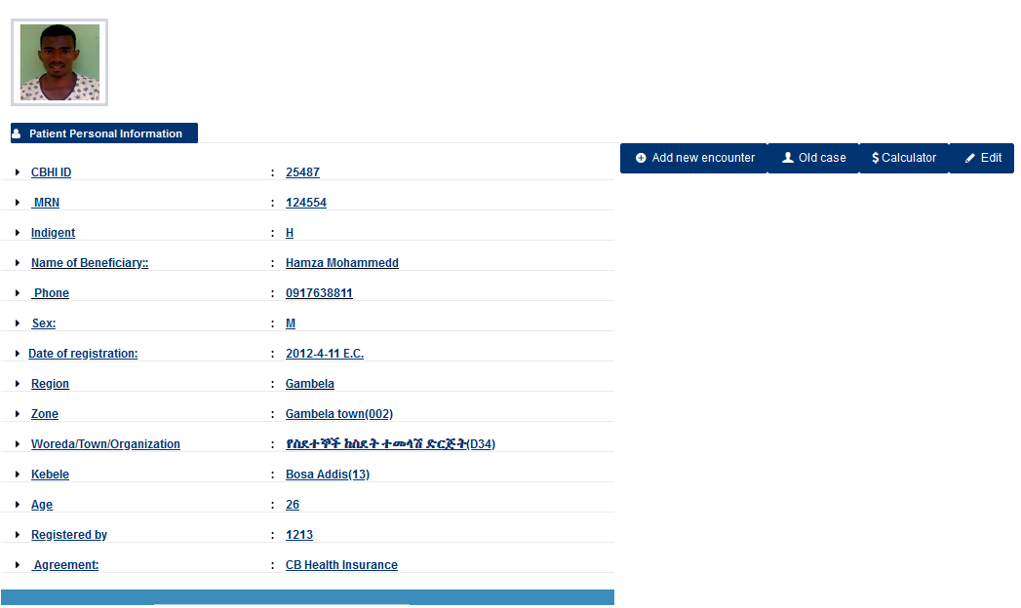
Patient profile-Search result
Click here new encounter

Slide 12
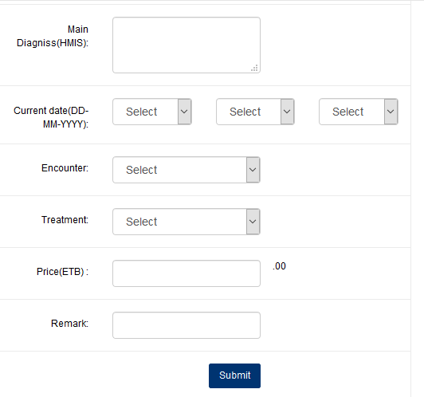
Create new encounter….
Encounter (OPD and IPD)
Treatment: Card
Price 5 or 10
Current date: DD-MM-YYYY

Slide 13

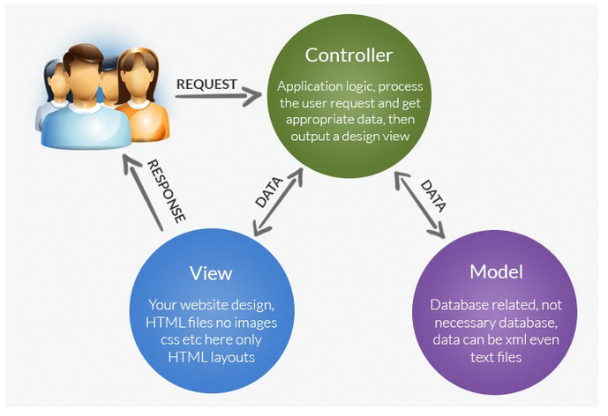
Technical Tips and Framework
Codeigniter- is open source application Development Framework - a toolkit - for people who build web sites using PHP .
Featured database classes with support for several platforms.
Extremely Light Weight
Fast/Full Page Caching
Uses M-V-C
Clean URLs
Security and XSS Filtering
Extensible
Friendly Community of Users
Thoroughly Documented
Large library of “helper” functions

Slide 14
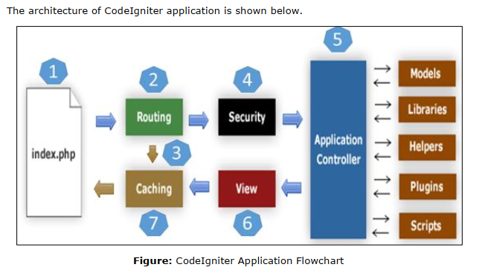
Architecture of Codeigniter

Slide 15
Architecture…
As shown in the figure, whenever a request comes to Codeigniter, it will first go to index.php page.
In the second step, Routing will decide whether to pass this request to step-3 for caching or to pass this request to step-4 for security check. If the requested page is already in Caching, then Routing will pass the request to step-3 and the response will go back to the user.
If the requested page does not exist in Caching, then Routing will pass the requested page to step-4 for Security checks.
Before passing the request to Application Controller, the Security of the submitted data is checked. After the Security check, the Application Controller loads necessary Models, Libraries, Helpers, Plugins and Scripts and pass it on to View.
The View will render the page with available data and pass it on for Caching. As the requested page was not cached before so this time it will be cached in Caching, to process this page quickly for future requests

Slide 16
The End Thanks You!

